Slide 1



Atliq Hardwares
Consumer Goods Ad Hoc Insights
Presented By: Sneha Mandal

Slide 2
Request 1
List of markets in which customer "Atliq Exclusive" operates its business in the APAC region

Slide 3
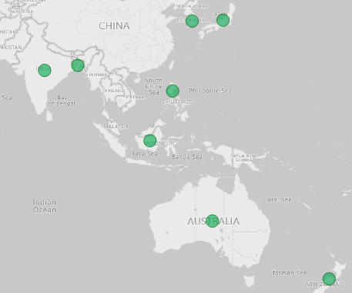
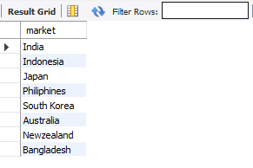
Output
Insights
The customer base of Atliq Hardware is in 27 countries belonging to 4 regions – APAC, EU, NA, LATAM – out of which countries belong to APAC region and are “Atilq Exclusive” customers.

Slide 4
Request 2
The percentage of unique product increase in 2021 vs. 2020

Slide 5

Output
Insights
There is 36% increase in unique products in the year 2021 that is amounting to a total increase of 89 unique products as compared to 2020.

Slide 6
Request 3
All the unique product counts for each segment

Slide 7
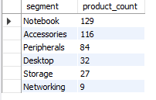
Output
The “Notebook” segment has highest number of unique products with a total of 129 products, while “Networking” segment has lowest number of unique products with only 9 products.
Insights

Slide 8
Request 4
Which segment had the most increase in unique products in 2021 vs 2020

Slide 9
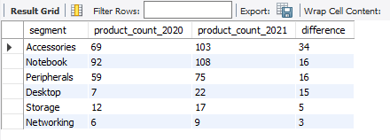
Output
Comparing the product count for 2021 and 2020, the “Accessories” segment has the highest increase with a difference of 34 total products. And “Networking” segment has the lowest increase with only 3 products.
Insights

Slide 10
Request
5
Products that have the highest and lowest manufacturing costs

Slide 11

Output
The highest manufacturing cost out of all the products is for “AQ HOME All in 1 Gen 2” with an amount of 240.53 and the lowest manufacturing cost is for “AQ Master wired X1 Ms” with an amount of 0.892
Insights

Slide 12
Request
6
Top 5 customers who received an average high pre_invoice_discount_pct for the fiscal year 2021 and in the Indian market

Slide 13
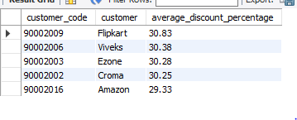
Output
Insights
For the fiscal year 2021 Flipkart, Viveks, Ezone, Croma and Amazon are the top 5 customers for Atliq Hardwares who are receiving the maximum average discount.

Slide 14
Request
7
Complete report of the Gross sales amount for the customer “Atliq Exclusive” for each month

Slide 15
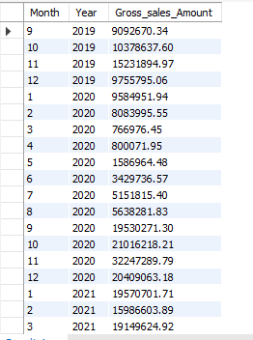
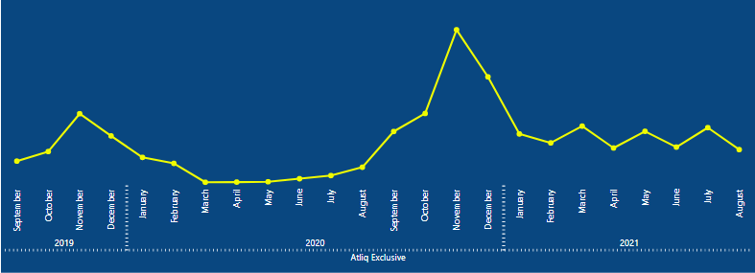
Output
In comparison with 2019 and 2021, the company has received the highest gross sale in November, 2020. Further, there is lowest steep in the months of March, April and May in the same year.
Insights

Slide 16
Request
8
In which quarter of 2020, got the maximum total_sold_quantity

Slide 17
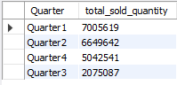
Output
Insights
For Quarter 1, our company sold maximum of its products in the year 2020, while our sale declined by Quarter 3 but we have recovered a lot by Quarter 4.

Slide 18
Request
9
Which channel helped to bring more gross sales in the fiscal year 2021

Slide 19
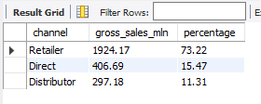
Output
Insights
In fiscal year 2021 the “Retailer” channel brought maximum gross sales with a total of 19 million (approx.) i.e., contributing 73% of the total gross sales.

Slide 20
Request
10
Top 3 products in each division that have a high total_sold_quantity in the fiscal_year 2021

Slide 21
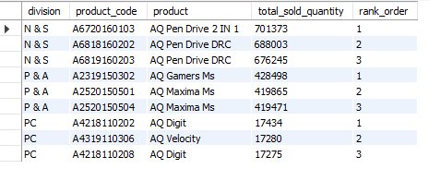
Output
Insights
“AQ Pen Drive 2 in 1”, “AQ Gamers Ms” and “AQ Digital” are the three top selling products from the division “N & S”, “P & A” and “PC” respectively.

